Slide 1
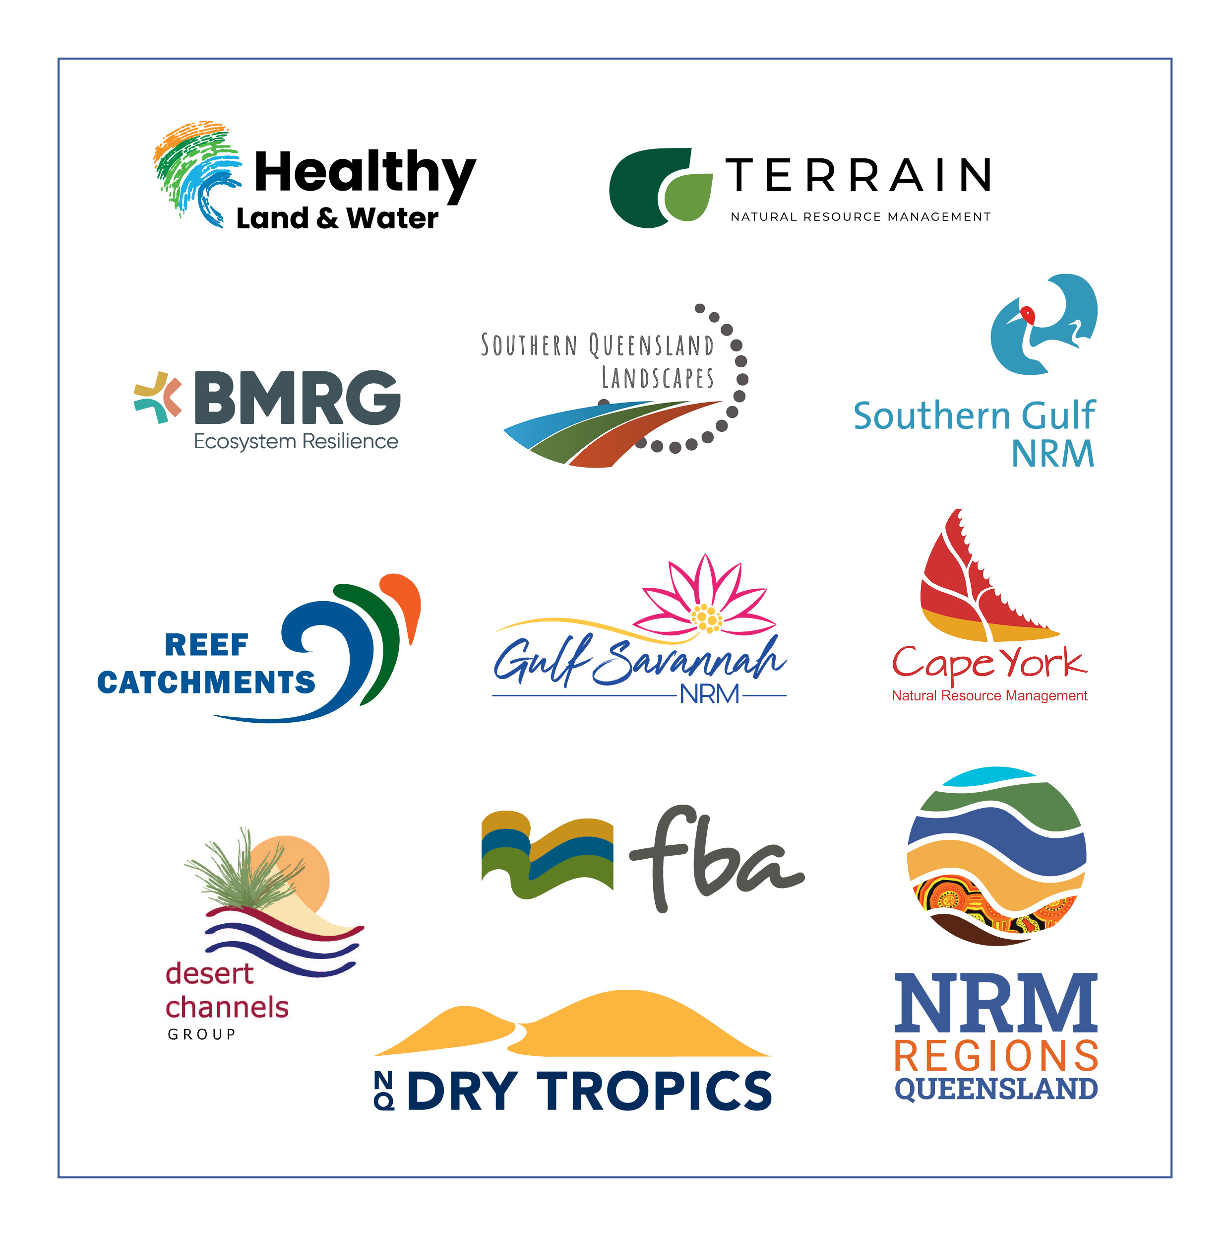
TURNING THE TIDE ON STATE INVESTMENT IN QUEENSLAND
Campaigning for success

Slide 2

PRESENTERS
CHRIS NORMAN
CEO
chris@nrmrq.org.au
SAMANTHA MORRIS
STRATEGIC COMMUNICATION
sam@wombatcreative.com.au

Slide 3
HOW WE DID IT
COST EFFECTIVE
COMMUNITY-DRIVEN
CRITICAL SERVICES
SAVING THE WORLD

Slide 4
HOW WE DID IT
COST EFFECTIVE
COMMUNITY-DRIVEN
CRITICAL SERVICES
SAVING THE WORLD
SOLVING THE EXTINCTION CRISIS
PROTECTING FOOD SECURITY
MANAGING WATERWAYS WORTH BILLIONS TO THE ECONOMY
SKILLED WORKFORCE IN 23 LOCATIONS
SHOVEL-READY PROJECTS

Slide 5
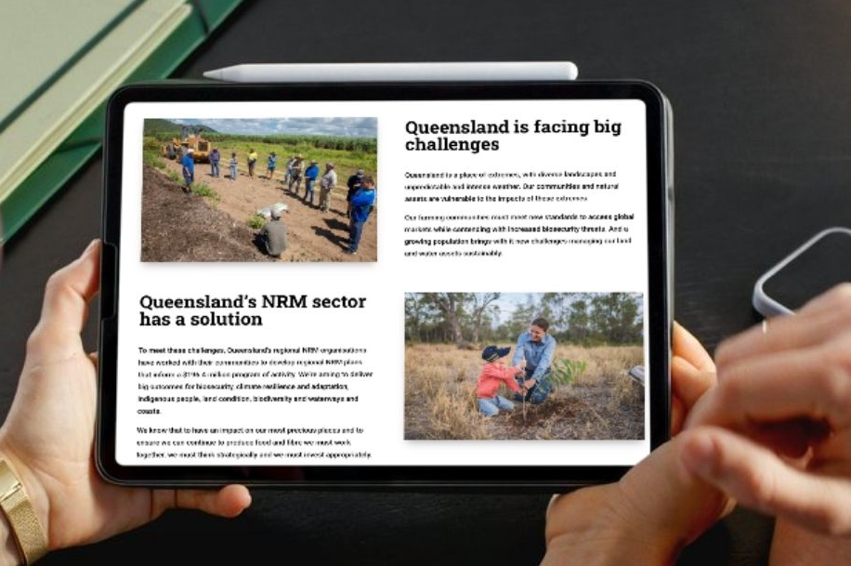
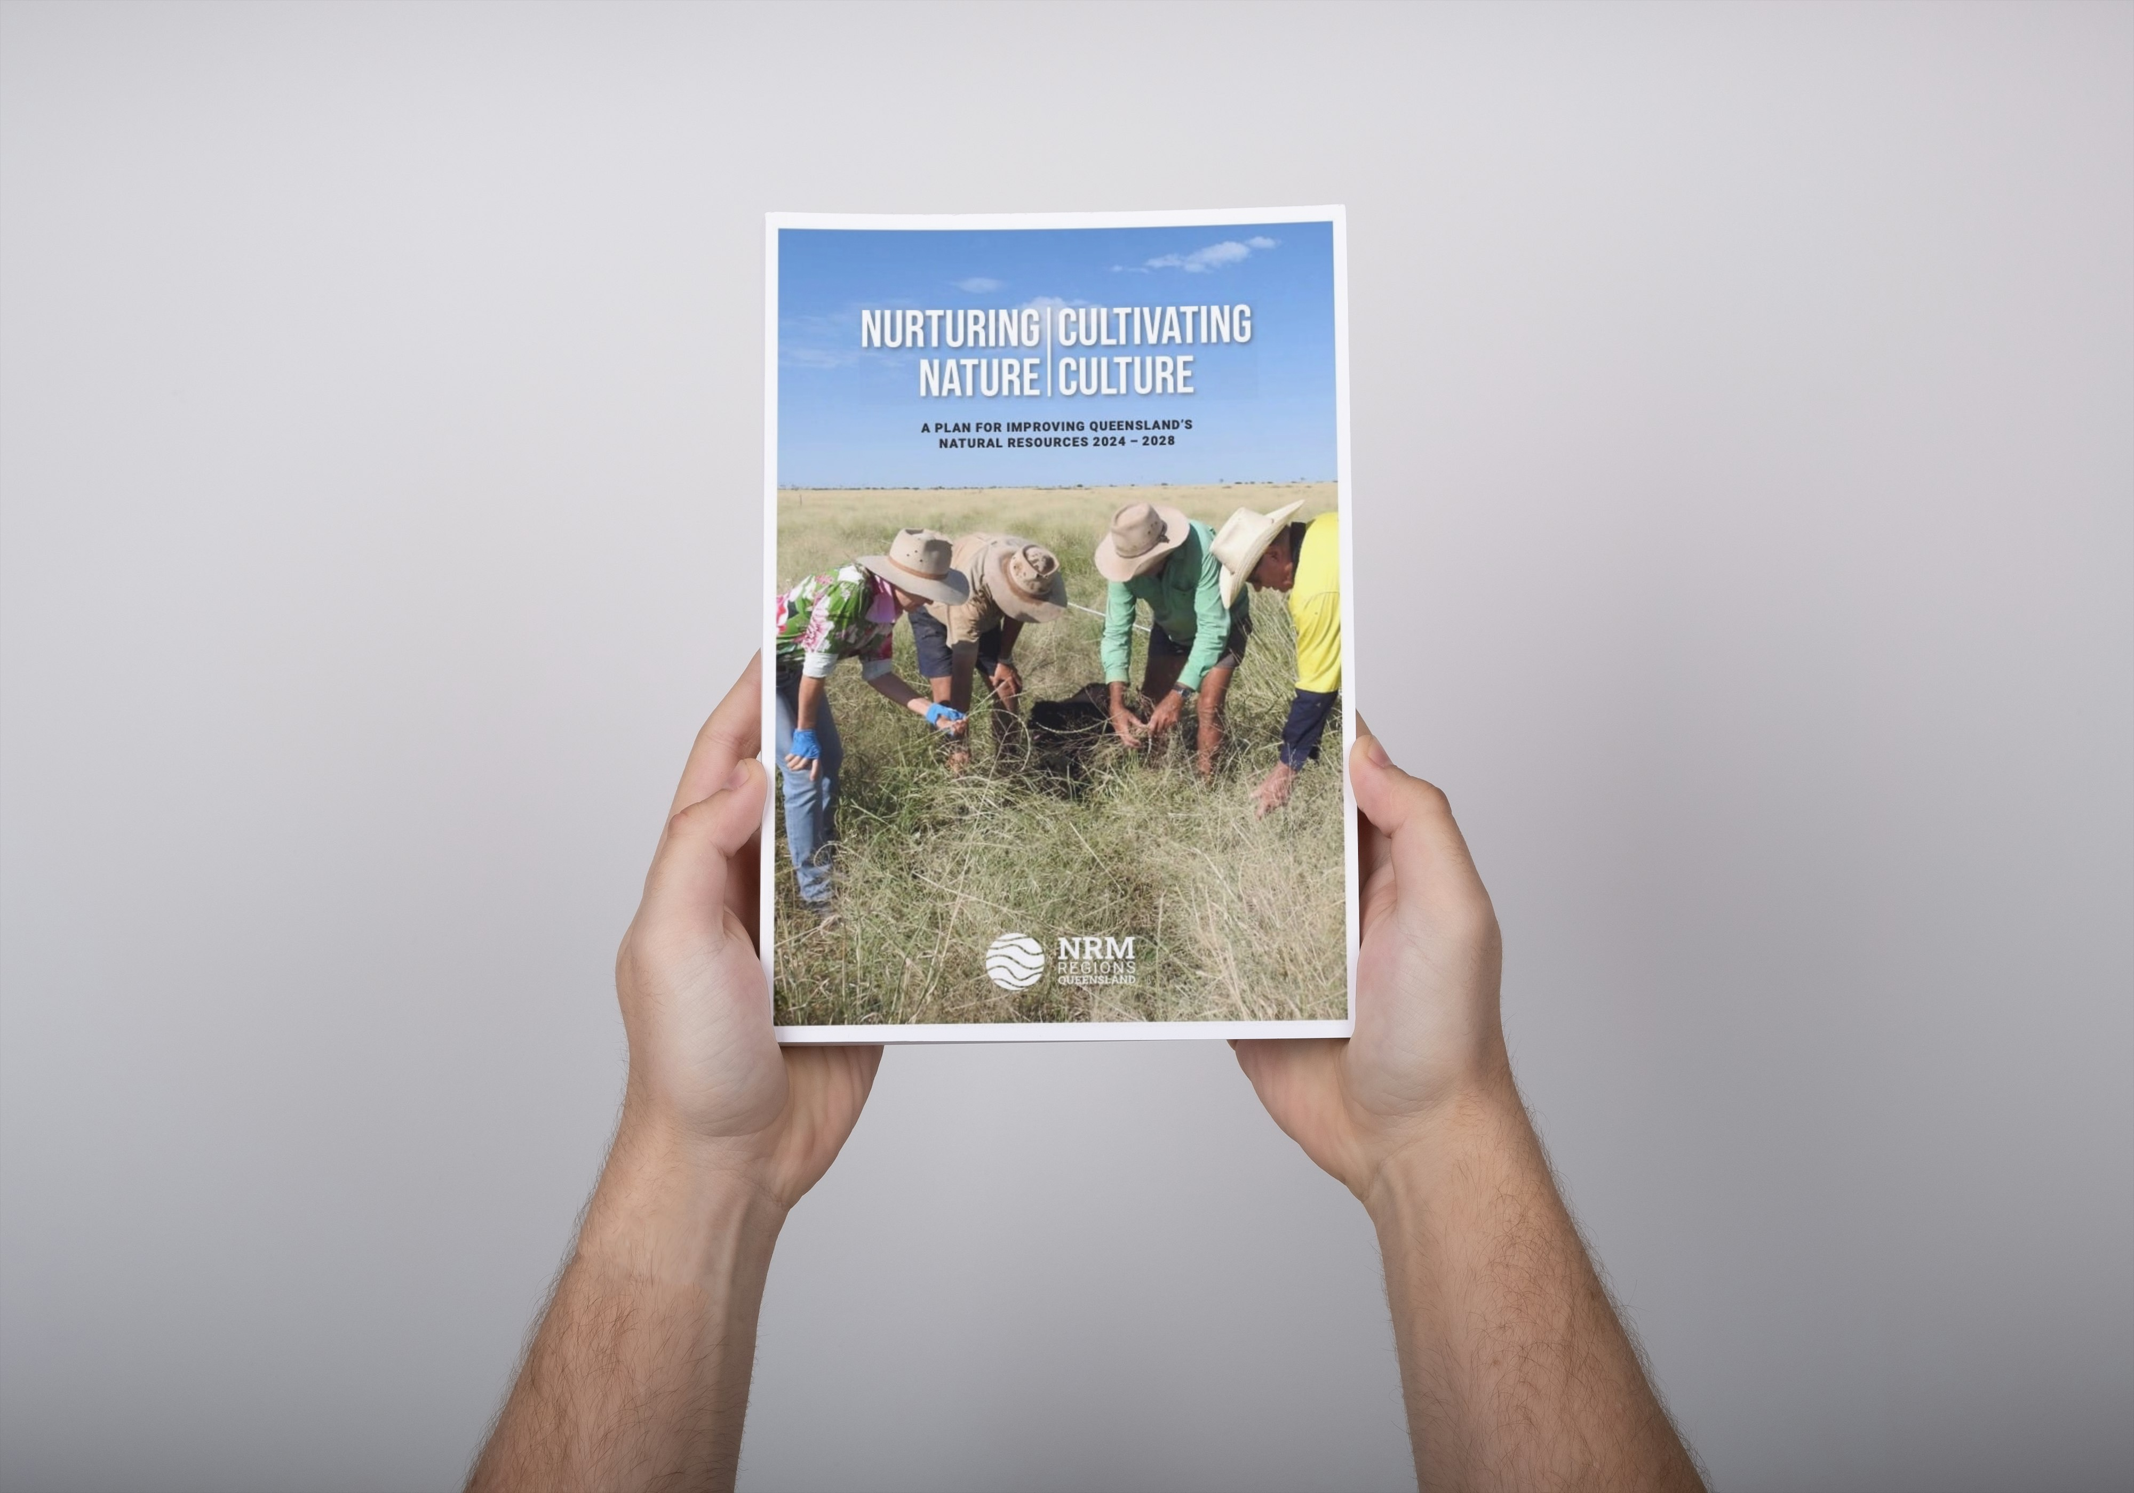
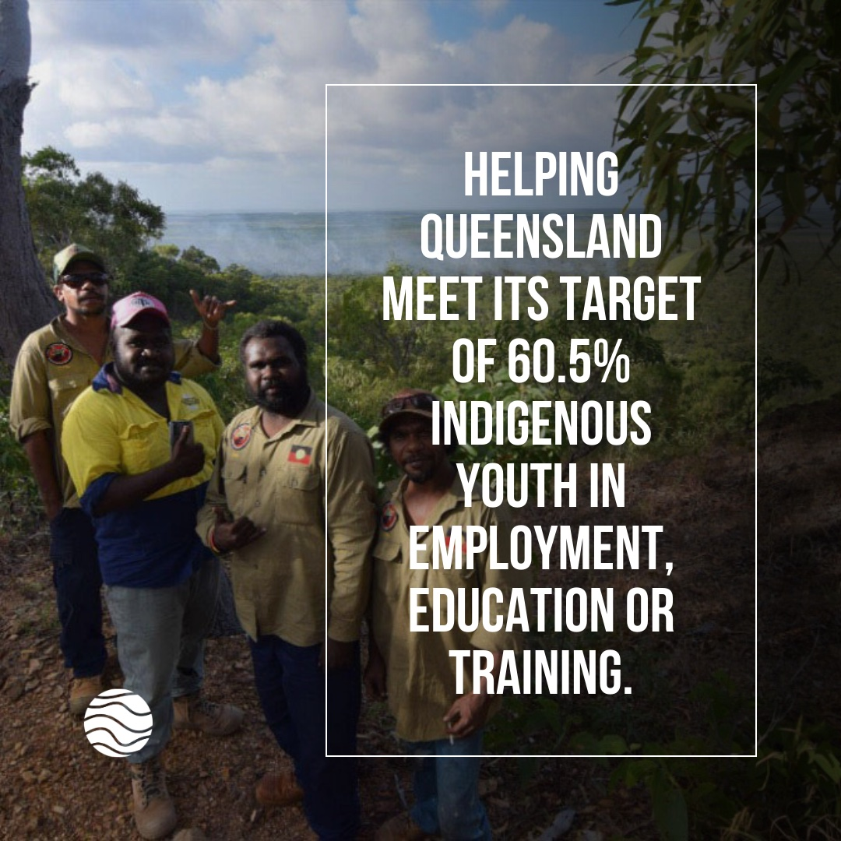
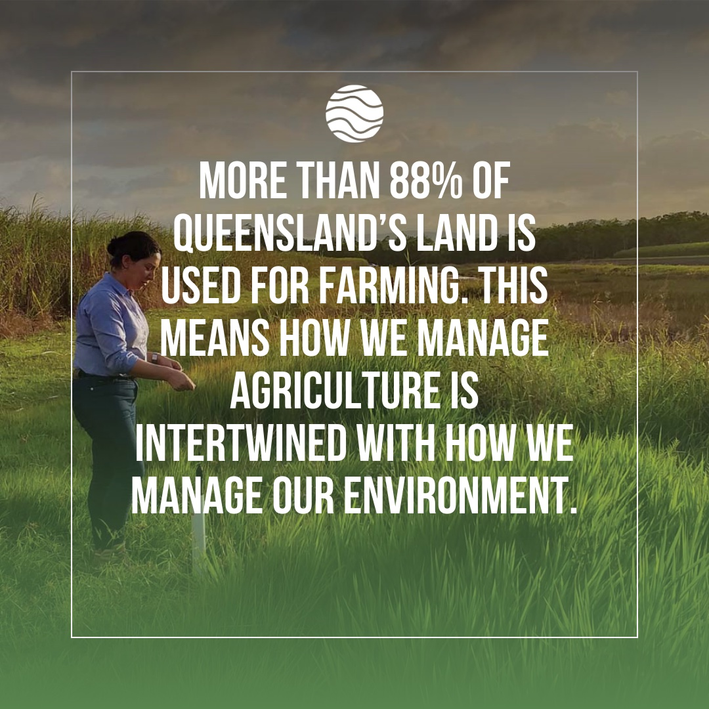
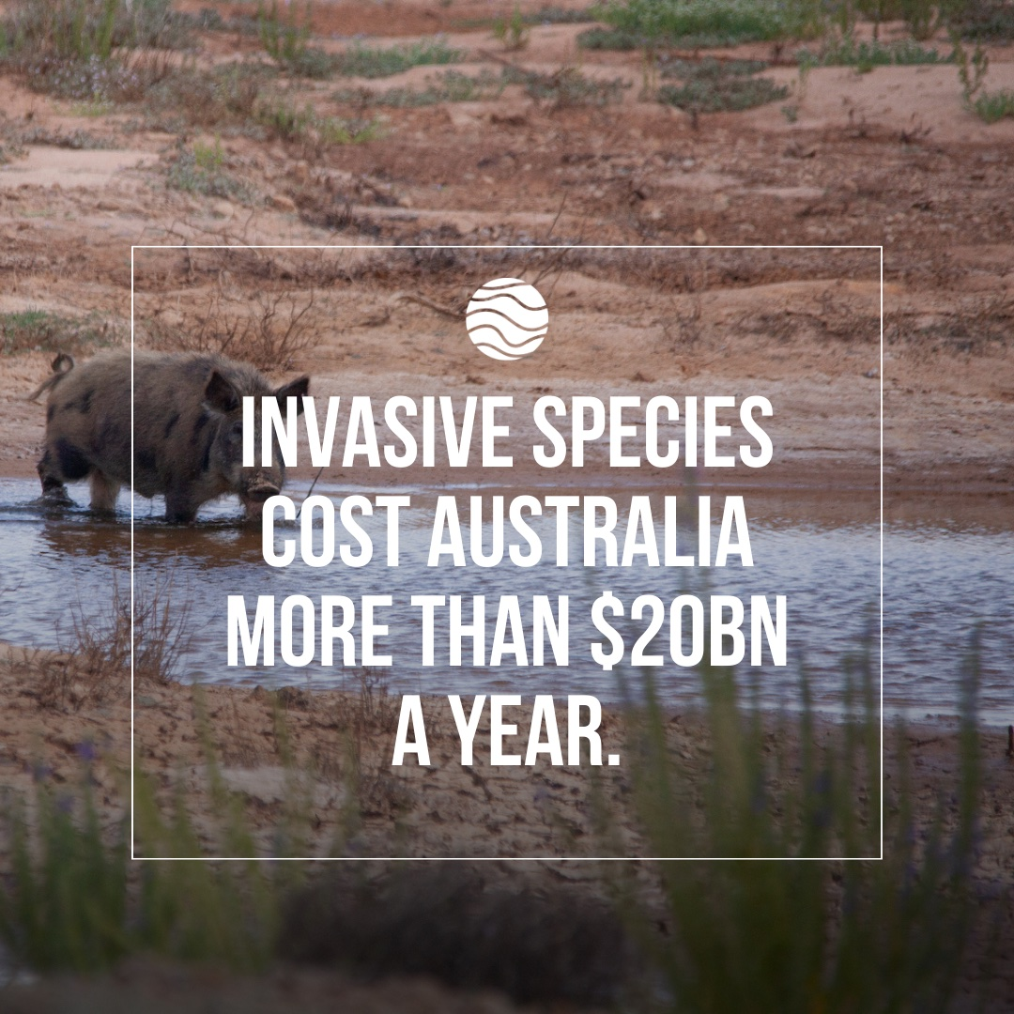
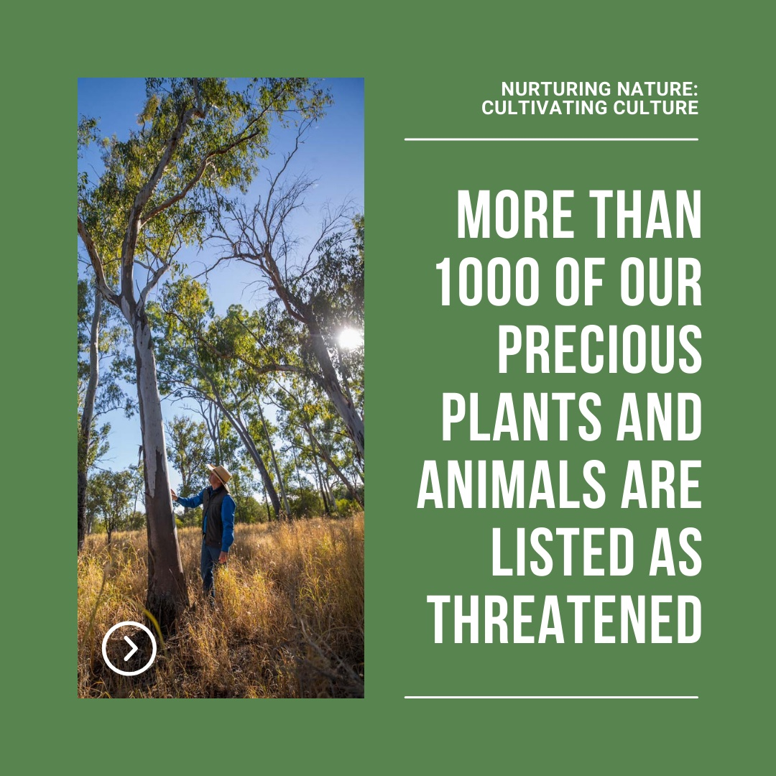
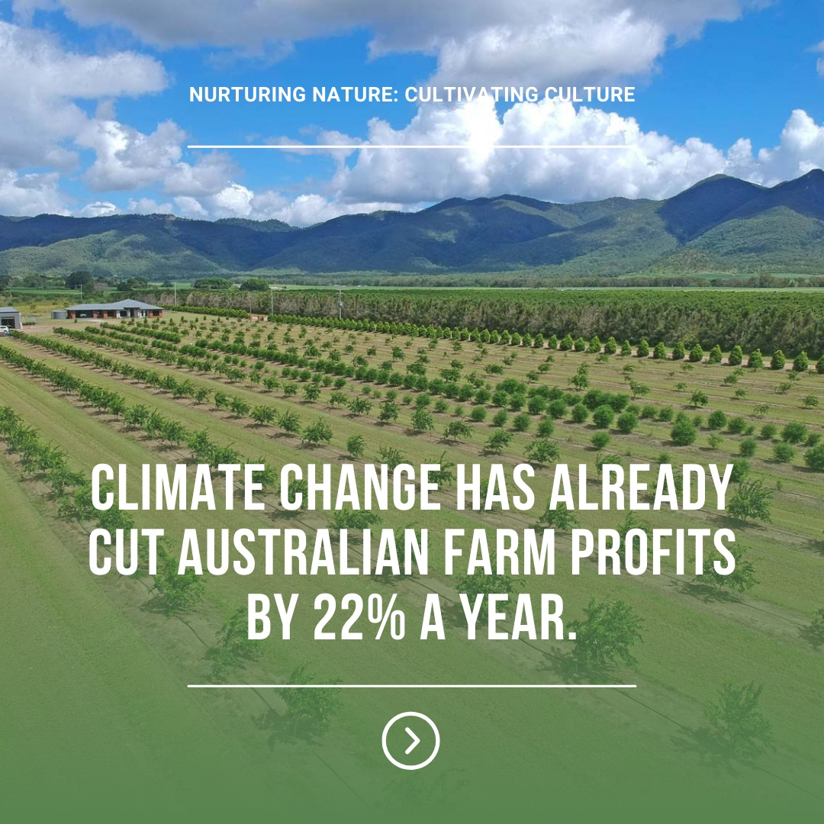

Slide 6
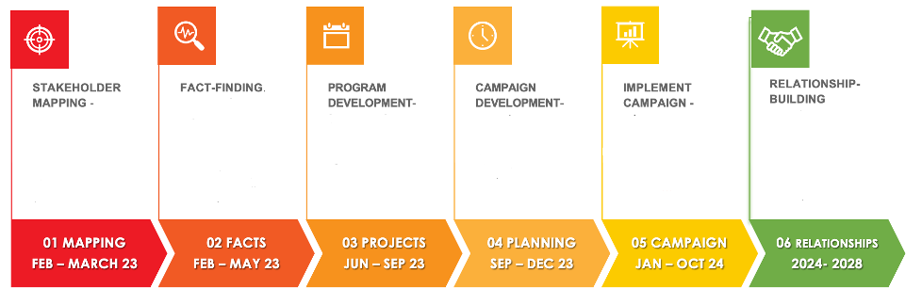
HOW WE DID IT

Slide 7
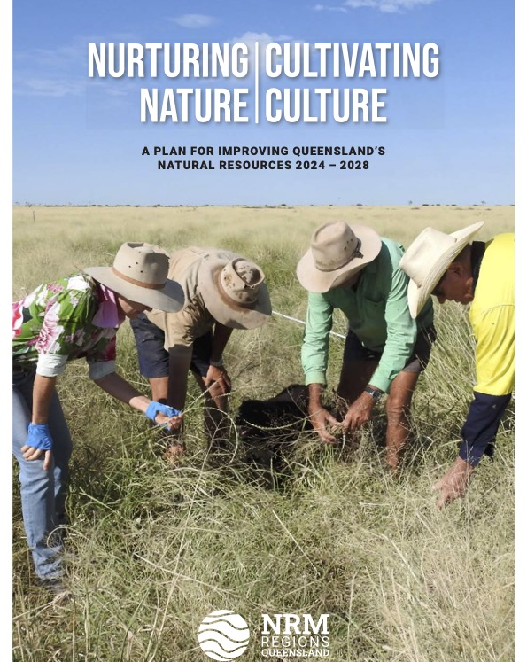
HOW WE DID IT
CLEAR GOAL – change our relationship with the Queensland Government
START EARLY – much earlier than you think

Slide 8
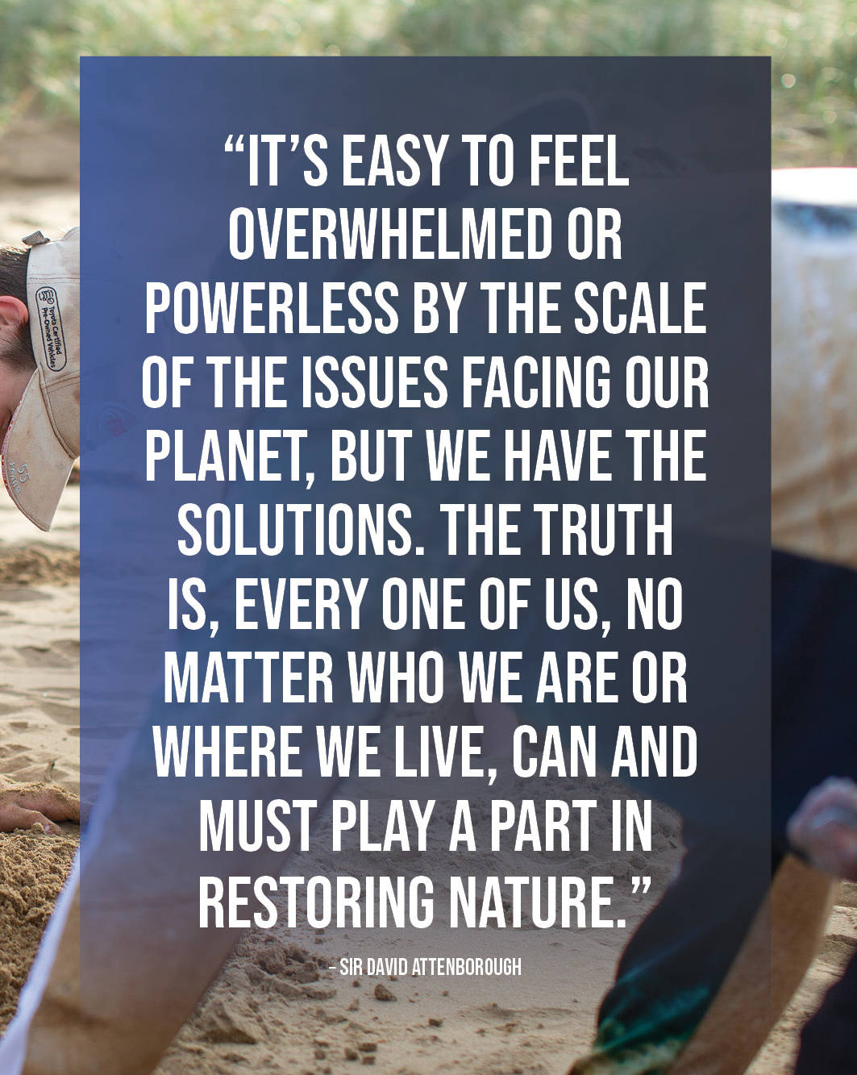
HOW WE DID IT
STAKEHOLDER RESEARCH
DEEP LISTENING
ADAPTING KEY MESSAGES

Slide 9
SUMMARY OF KEY FEEDBACK
HOW FUNDING IS USED
”There’s a perception that you’re administratively expensive and give funds to farmers for equipment they can sell on.”
GOVERNANCE INEFFICIENCY
”You come to the Minister as separate organisations, so there is no sense that you are one state or national movement.”
COMMUNICATING IMPACT
”You need to consistently and collectively lift your profile. It often feels like NRMs are always requesting handouts.”
ABILITY TO INFLUENCE
”You have lack of influence and clout. You’re not on our radar.”

Slide 10
HOW WE DID IT
STAKEHOLDER RESEARCH
Market research – audiences: politicians and advisers, governments, peak bodies, communities
Deep listening – targeted one-on-one conversations with politicians and their advisers to find what they ‘really think’ of NRM
Stakeholder mapping – using power / interest matrix with CEOs and Chairs identifying relationships
Political mapping – marginal seats, influential party members (not just politicians), and champions
CRM – 250 meetings tracked through a Google Sheet that all CEOs and Chairs accessed and updated in real time.
Developed and adapted key messages and our pitch based on what we learned

Slide 11
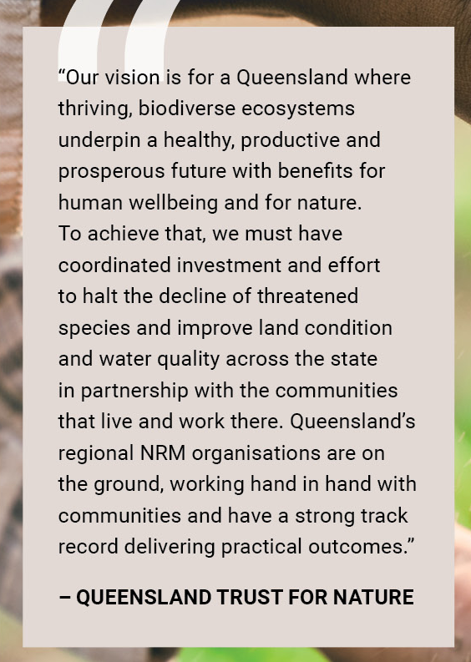
HOW WE DID IT
CAMPAIGN MENTALITY
Created from the top-down, bottom-up
46 regionally-led signature projects
Grouped into 7 statewide themes
Packaged together as one ask
Prioritising data, facts, science
Clear on problem we’re solving
3 tailored versions (Labor, LNP, Katter)
Clear costings
Public support from statewide partners
Strong campaign visuals, identity, messages

Slide 12
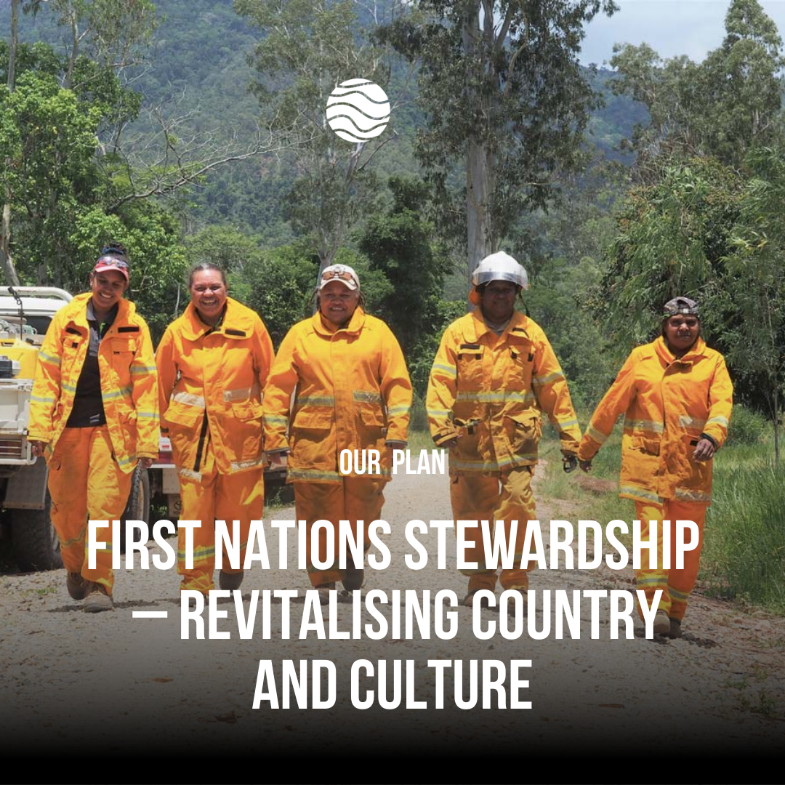
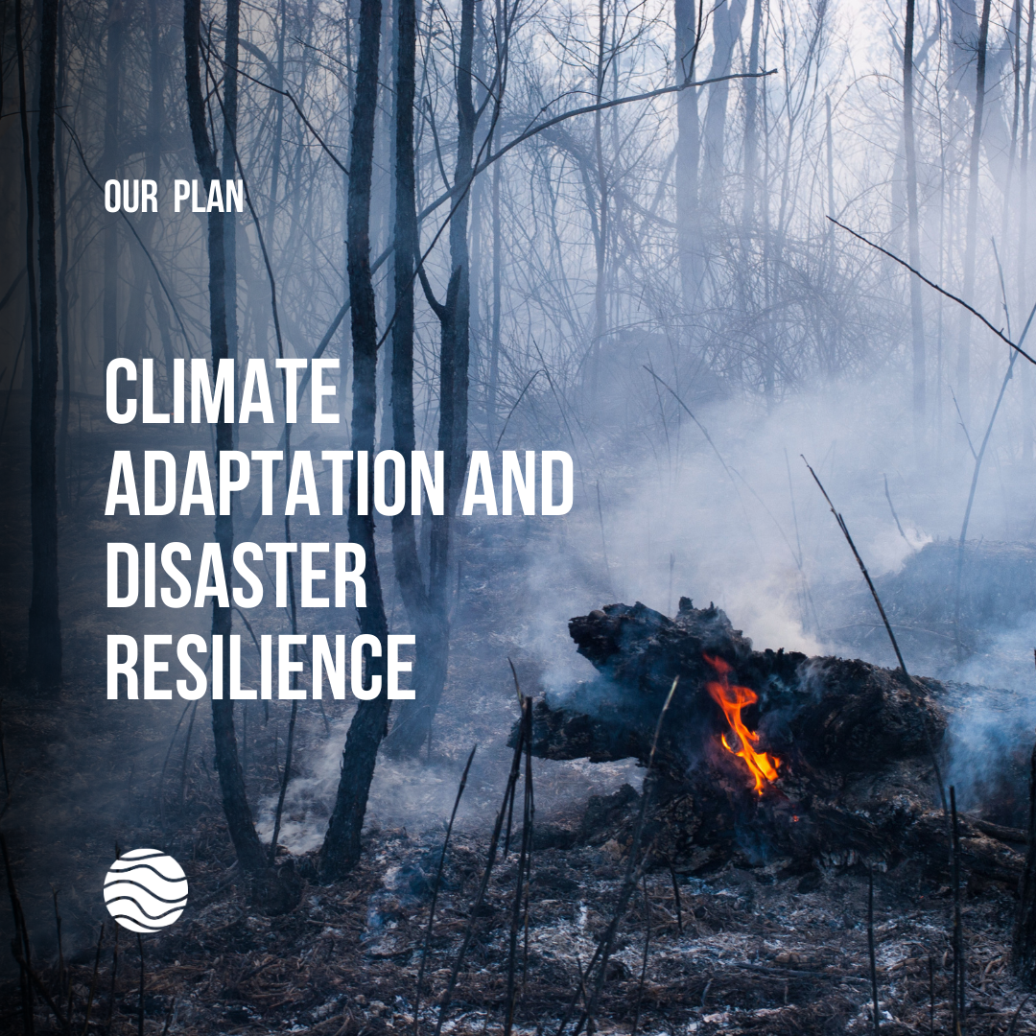
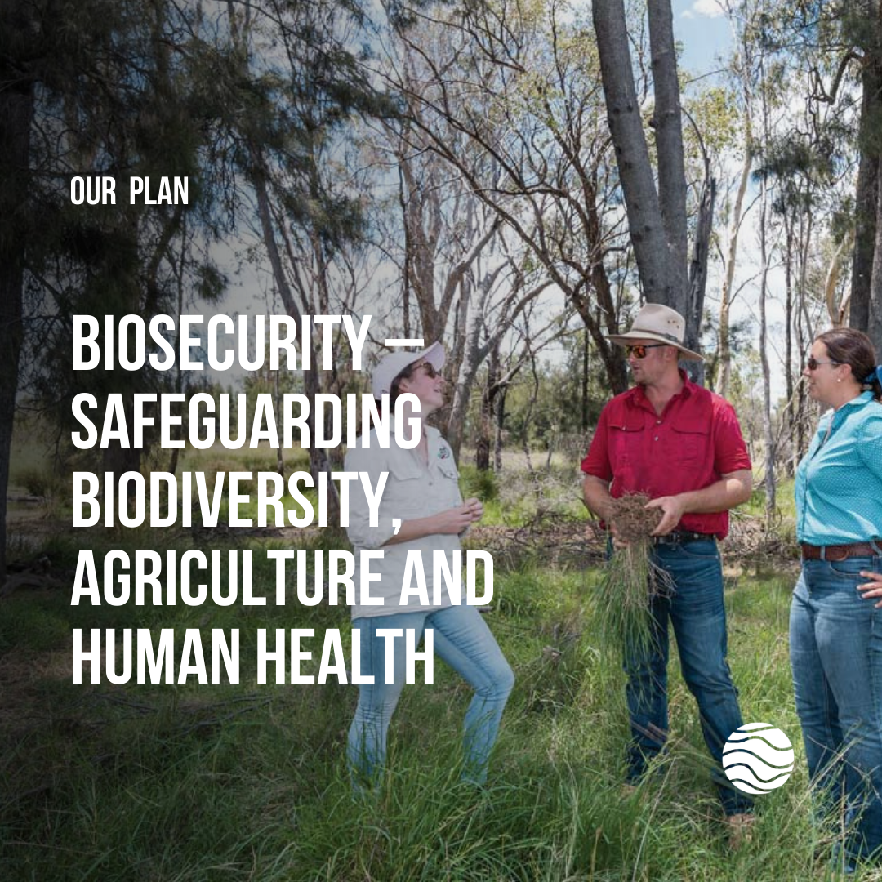
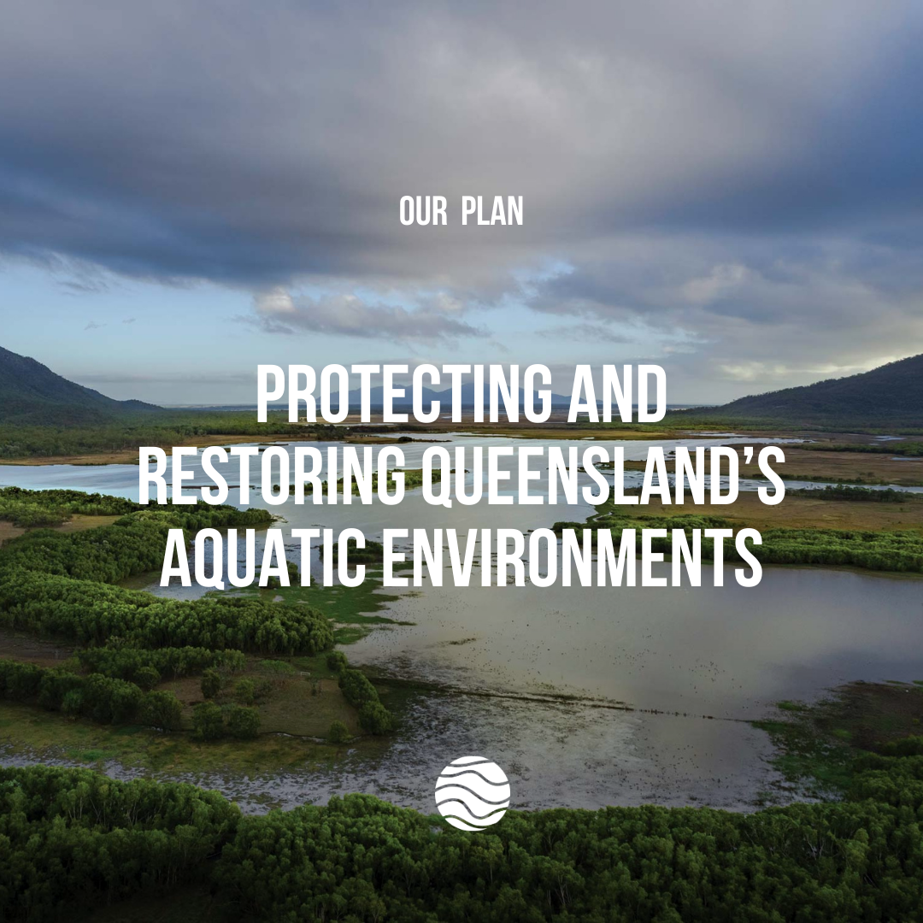
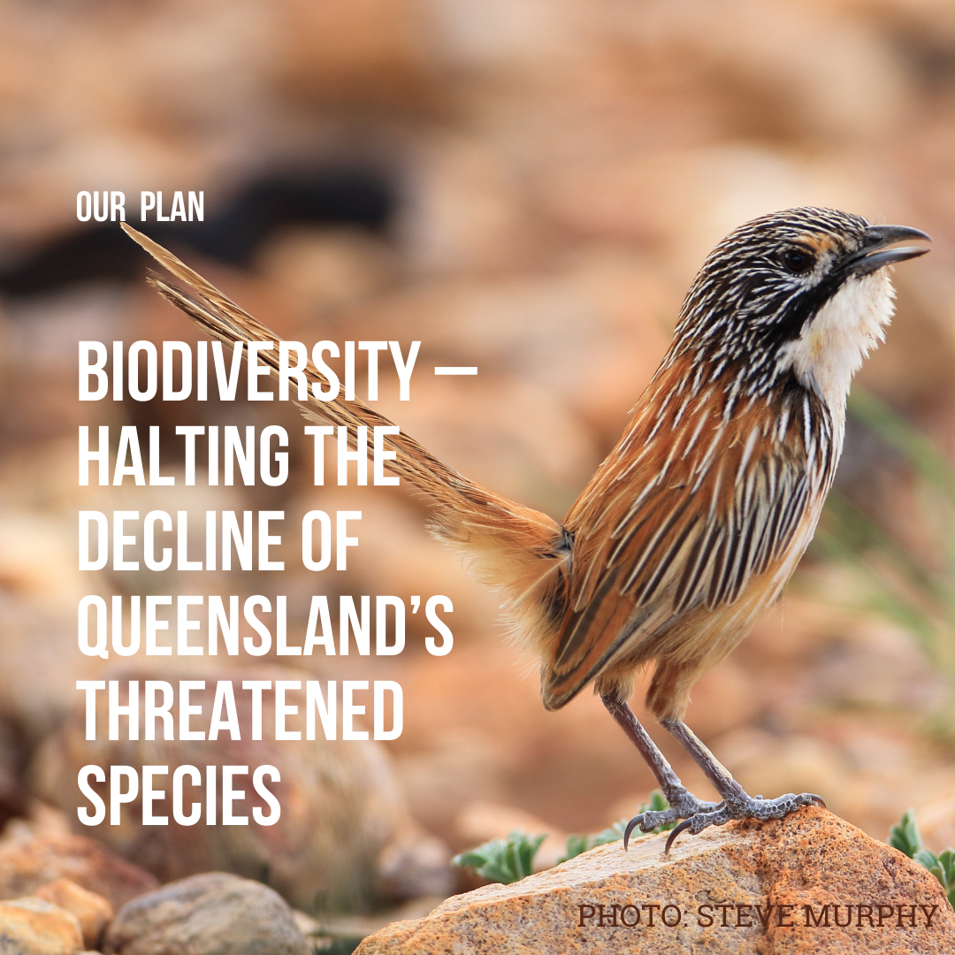
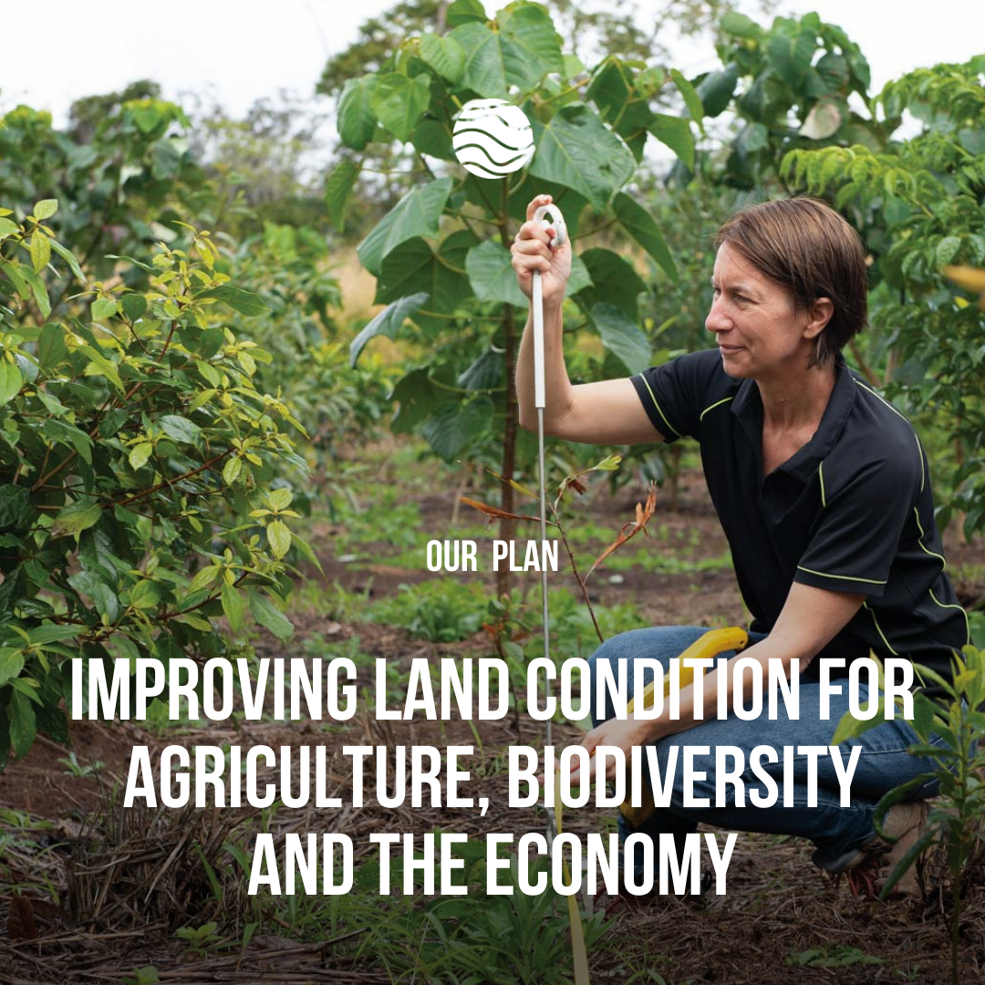
HOW WE DID IT

Slide 13
HOW WE DID IT
ONE VOICE,
MANY FACES

Slide 14
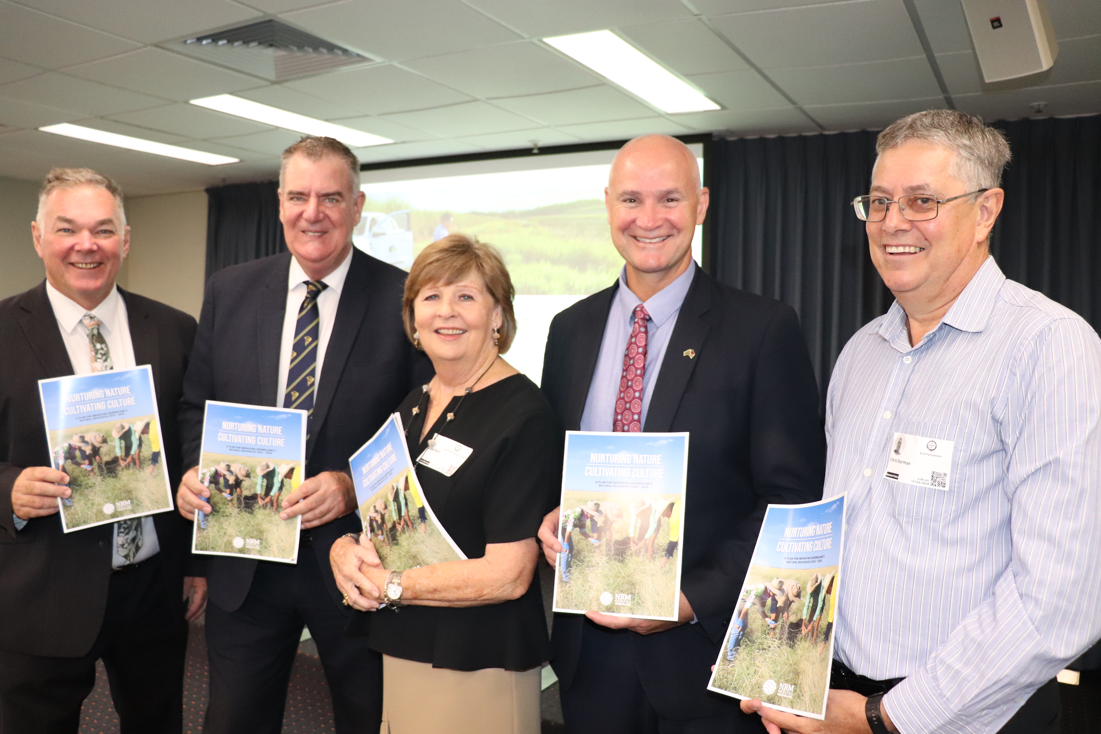
HOW WE DID IT
LAUNCH EARLY
LAUNCH LOUD

Slide 15
HOW WE DID IT
RELENTLESS ADVOCACY
  Saturation at state and regional level
  One ask. One voice. Many faces
  Clear, consistent and unwavering messaging

Slide 16
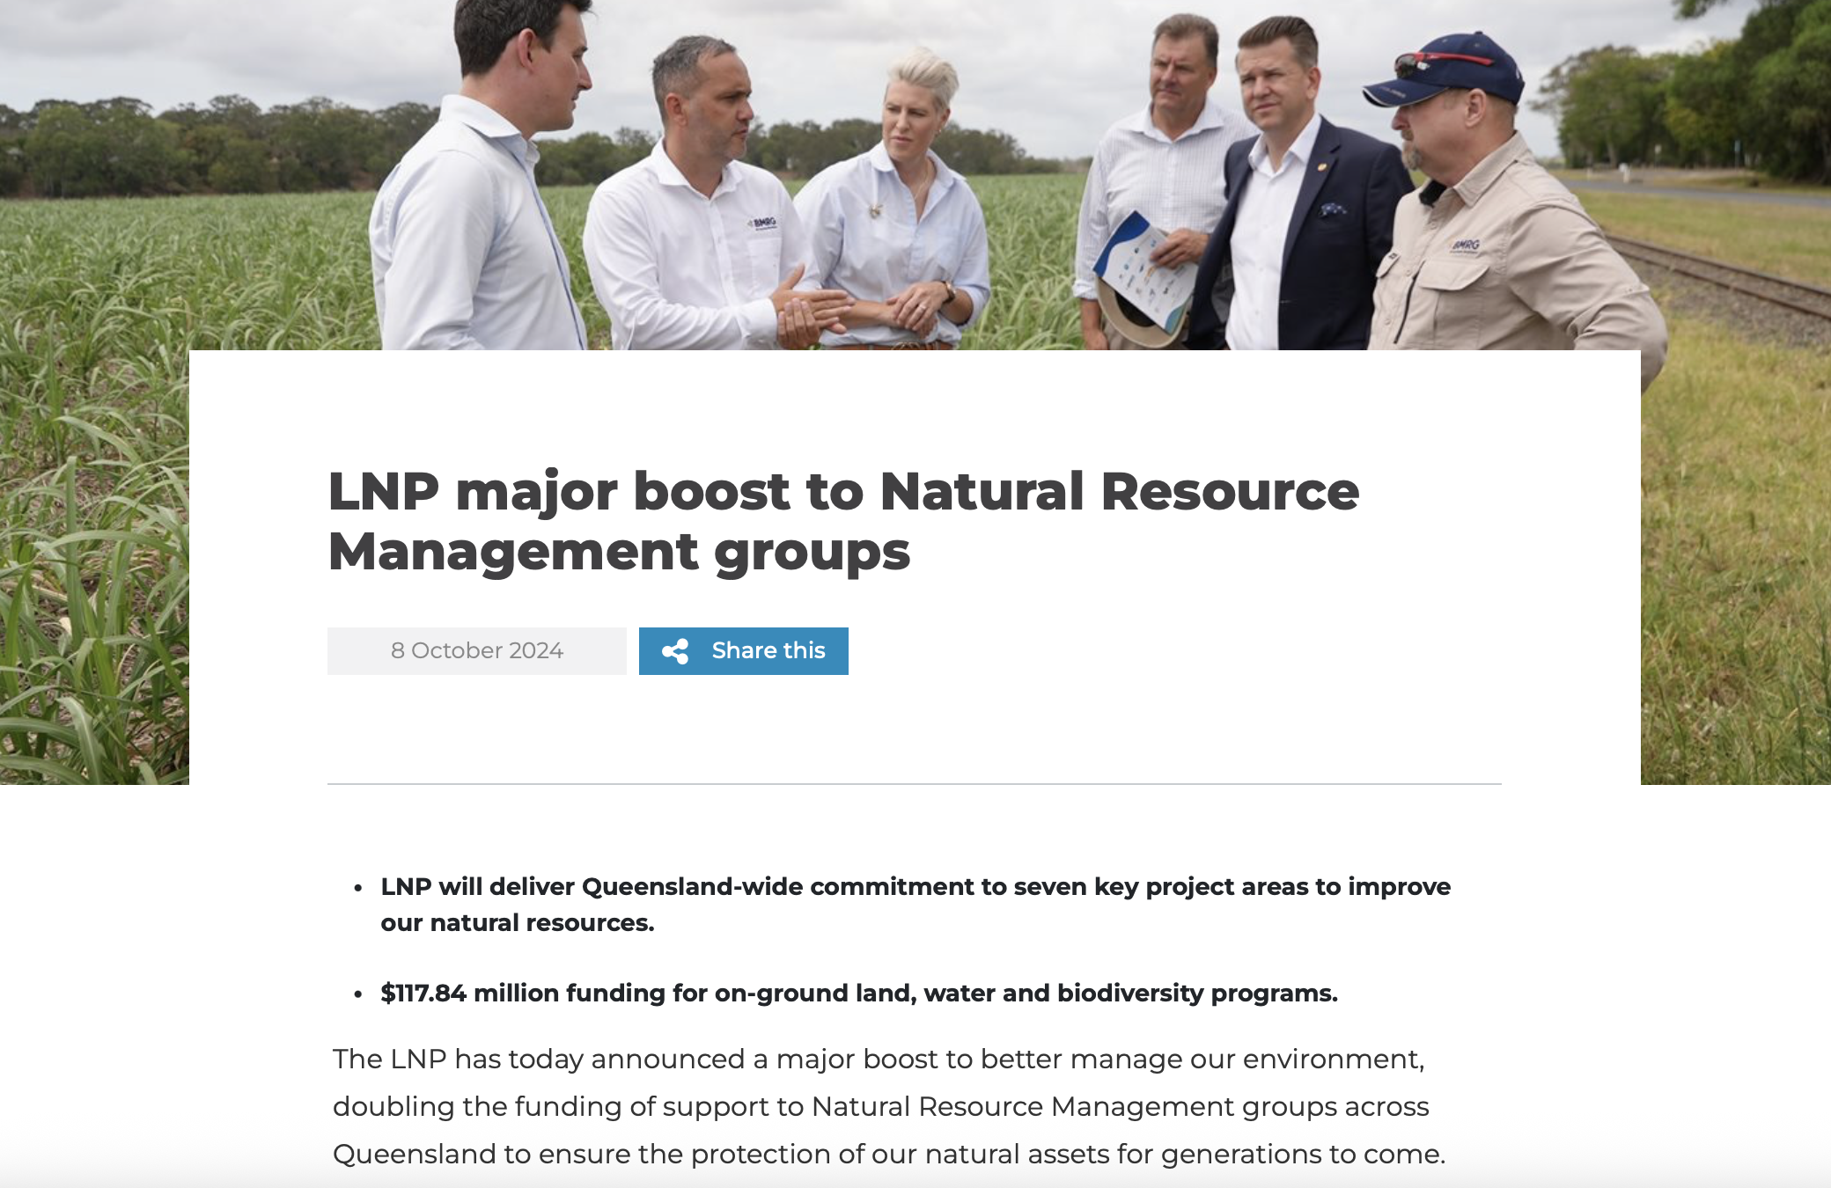
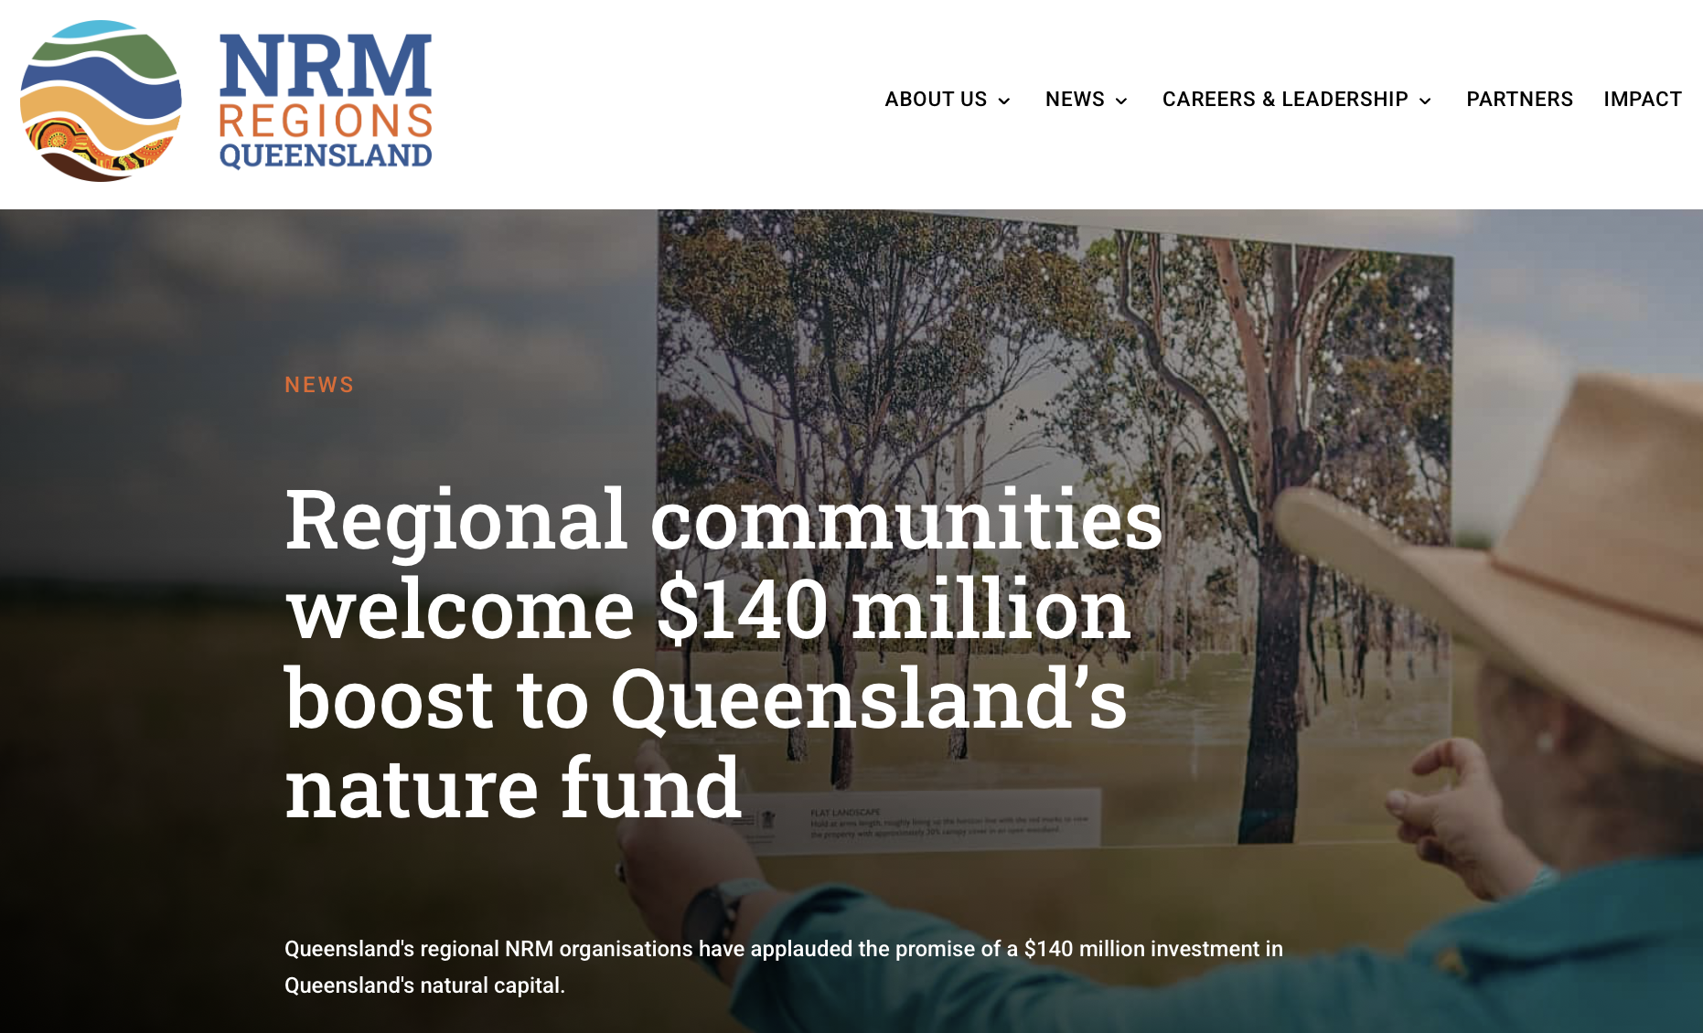
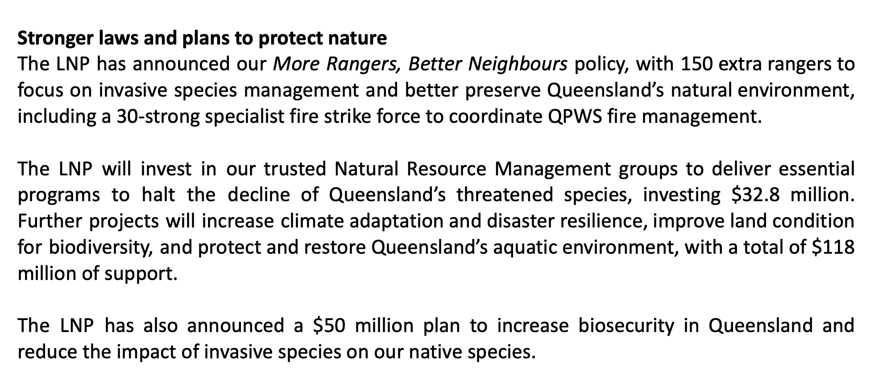
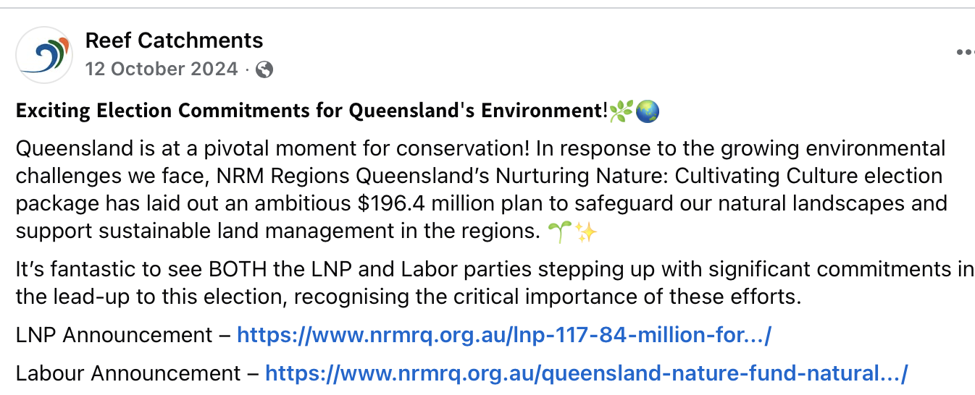
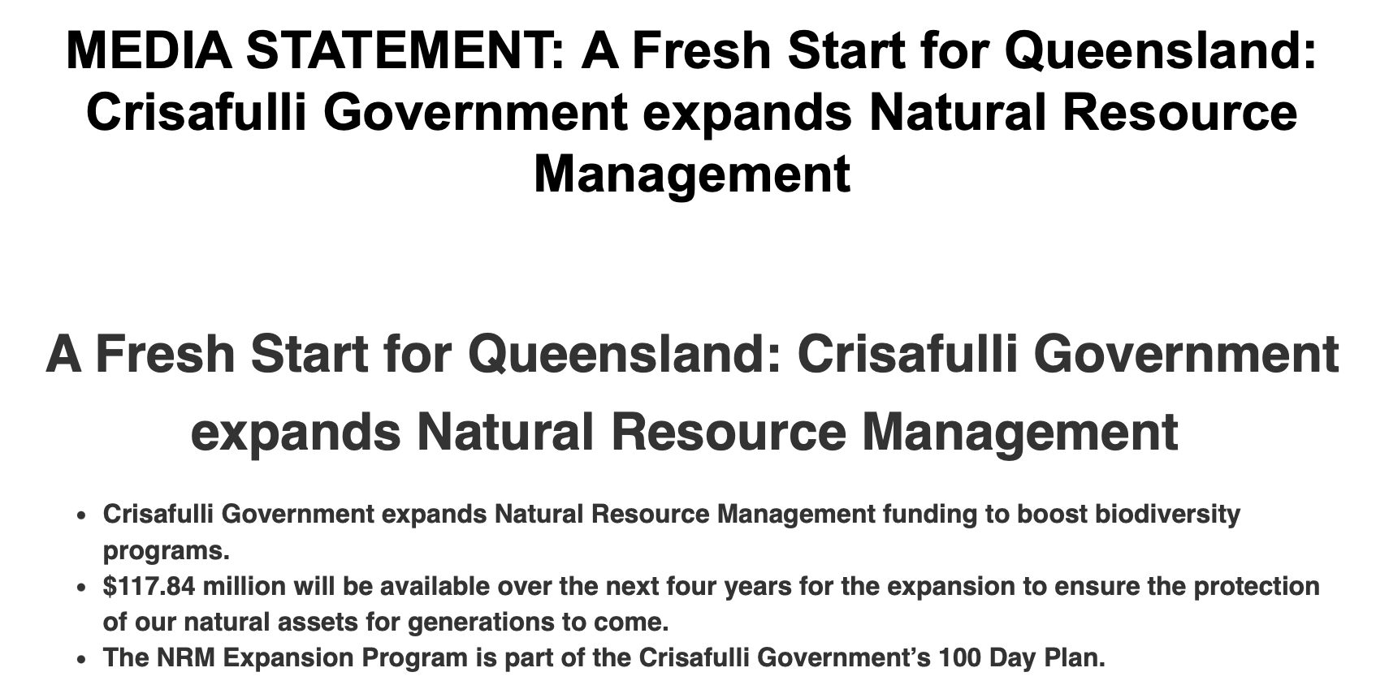
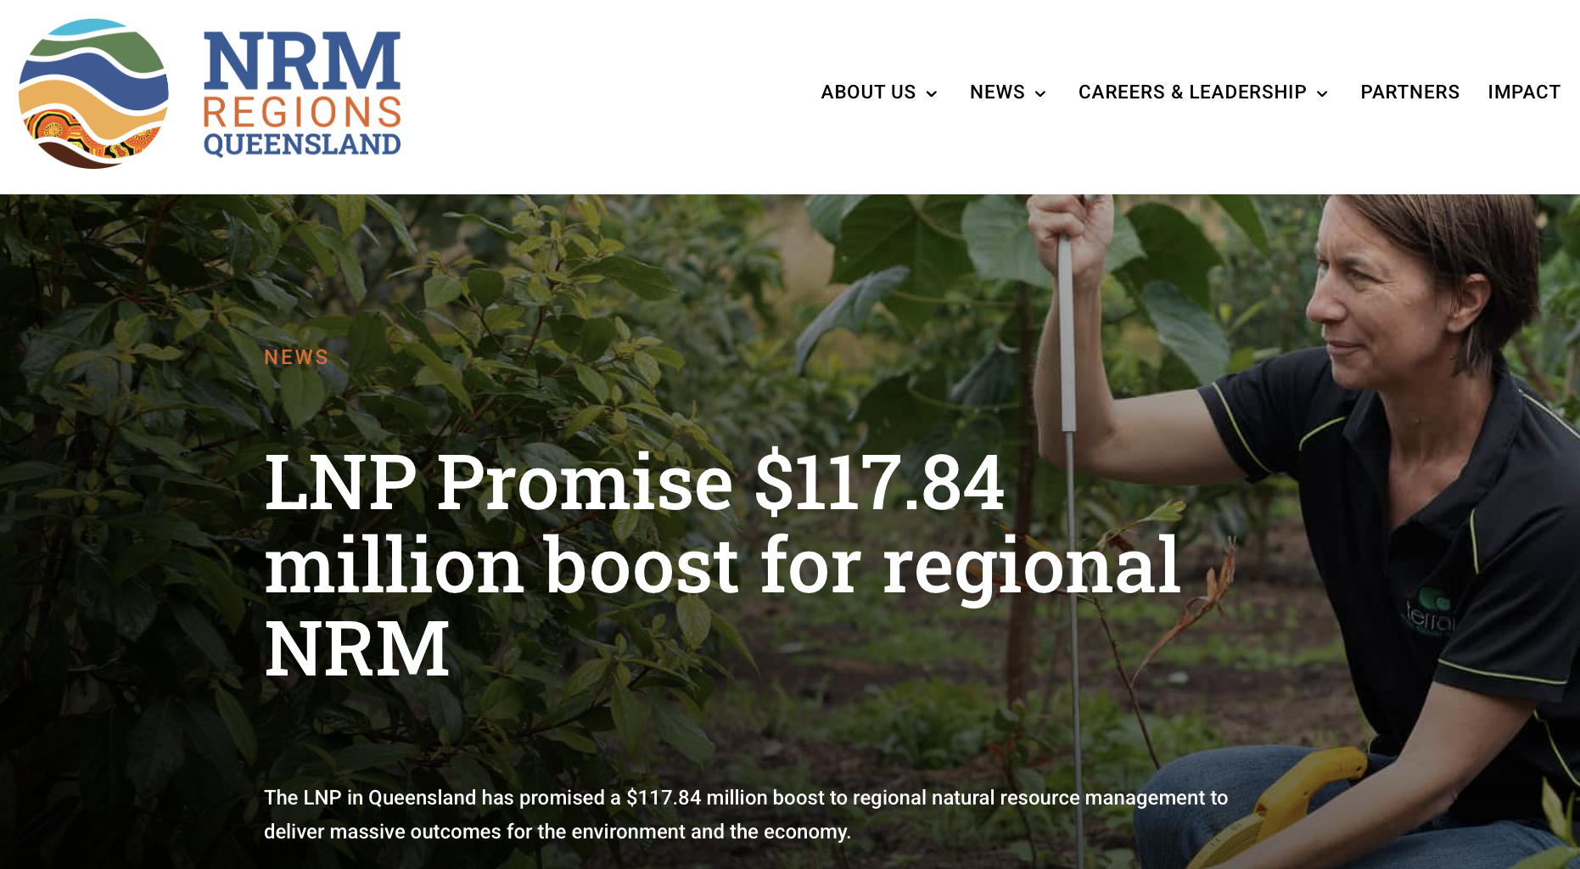
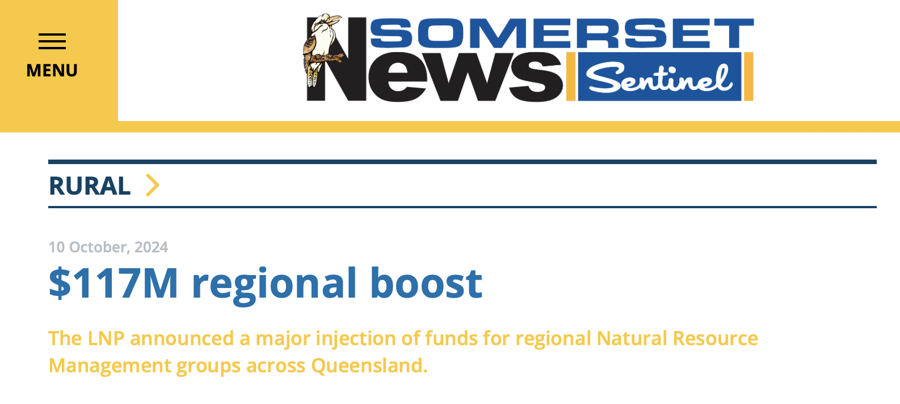

Slide 17
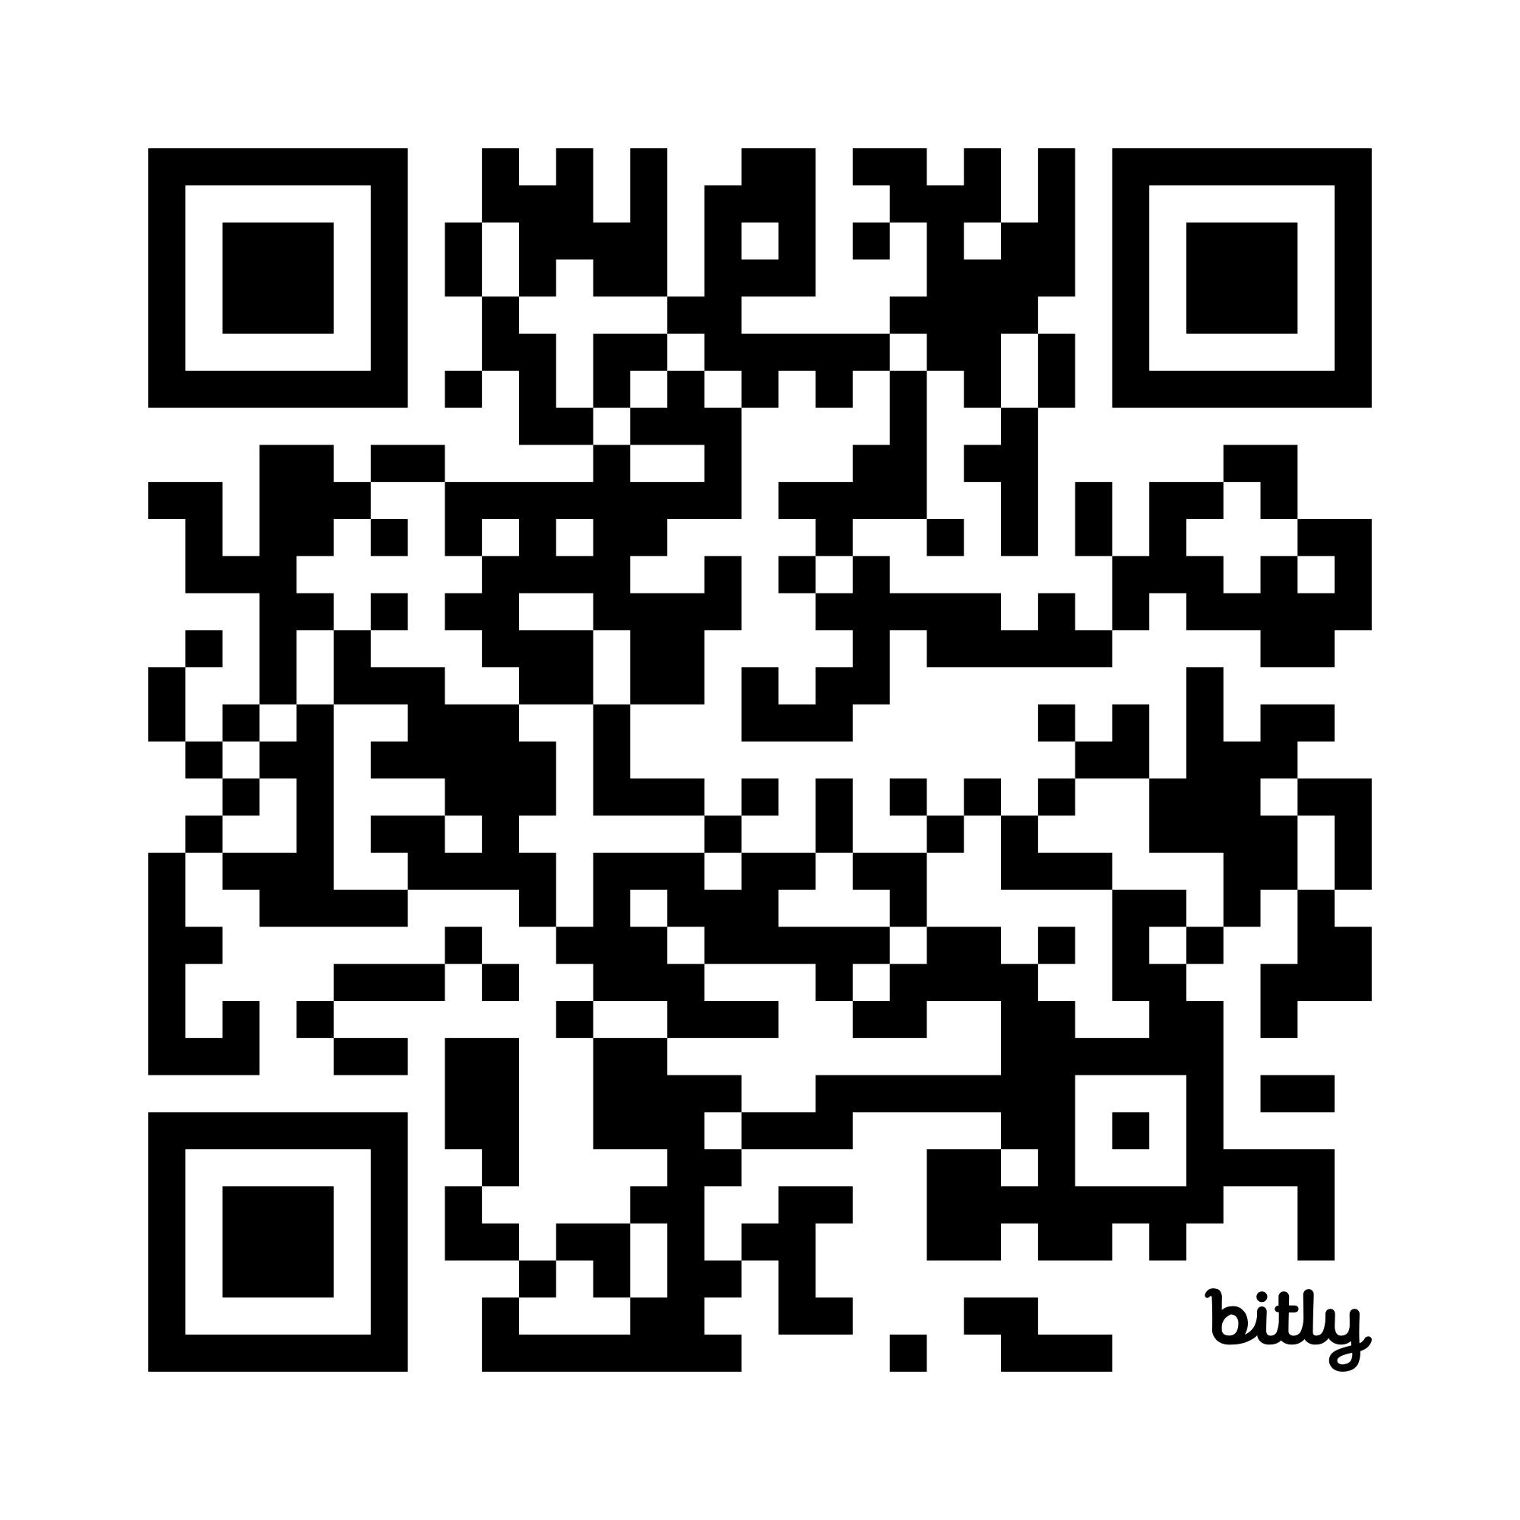
DOWNLOAD
PLAYBOOK

Slide 18
OUR STRATEGIES
HAVE A CLEAR GOAL
START EARLY
LISTEN DEEPLY AND BE PREPARED TO ADAPT
HAVE A CLEAR ASK, BUILT FROM THE GROUND-UP AS WELL AS THE TOP-DOWN
DEVELOP AN ACTUAL CAMPAIGN – AUDIENCES, KEY MESSAGES, TACTICS
ONE VOICE, MANY FACES. BRIEF EVERYONE REGULARLY
LAUNCH EARLY AND LOUD
ADVOCATE RELENTLESSLY
DOCUMENT + ANALYSE EVERYTHING

Slide 19
KEY LEARNINGS
KEEP THE STORY SIMPLE, but don’t oversimplify (use facts and data)
WORK AS A TEAM: one voice, many faces
AGENCY RELATIONSHIPS are as critical as political ones
MINISTERIAL SUPPORT does not mean system-wide understanding
WINNING THE ASK is the start of the next advocacy cycle

Slide 20
WITH THANKS TO OUR ELECTION WORKING GROUP
Julie Boyd (Chair NRMRQ)
Chris Norman (CEO NRMRQ)
Julie McLellan (CEO Healthy Land & Water)
Scott Crawford (CEO NQ Dry Tropics)
Zoe Williams (CEO Gulf Savannah NRM)
Billy Thomson (NRMRQ)
Samantha Morris (Consultant).

Slide 21
DOWNLOAD
PLAYBOOK +
PRESENTATION

Slide 22
THANKS ☺
CHRIS NORMAN
CEO
chris@nrmrq.org.au
SAMANTHA MORRIS
STRATEGIC COMMUNICATION
sam@wombatcreative.com.au

